Slide 1
TMDB 5000 Movies – Group E
Vanessa Caldera
Matthew Hill
Tim Tieng

Slide 2

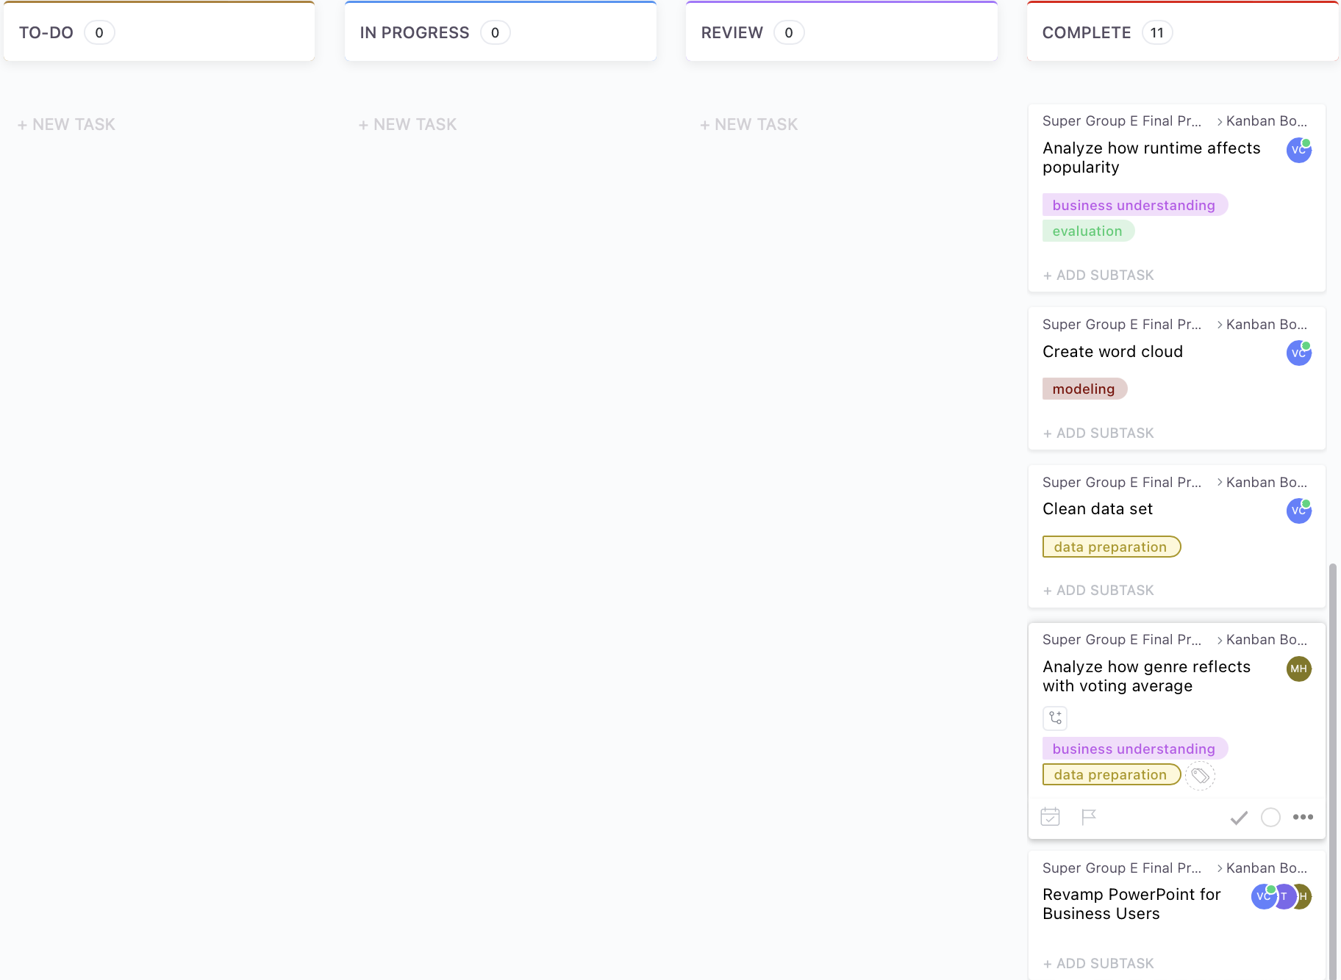
Group E Kanban Board
Kanban Board Part1:
Kanban Board Part2:

Slide 3
Project Milestone Quad-chart
What was accomplished since last updated
Completed Multi-Variable Analysis
PowerPoint Touch-ups
Finished R-Code Technical Document
Discussed Presentation Assignments
What is working well for the team?
Task delegation
Communication
Review Processes
Issues
Many ideas to go about the data, but limited time
Plans for next update
Project Complete!

Slide 4
Problem Statement
Utilizing public movie data outlined in the dataset, “TMDB 5000 Movie Dataset” provided by Kaggle, can a team of Data Scientists effectively predict or determine the factors that influence a movie’s popularity rating?

Slide 5
Task 1 – Analyze the relationship between budget and popularity
Question – Determine if there is a relationship between a movie’s production budget and its popularity? Group E wants to determine if the more money invested to create a movie is a good starting point to conduct multi-variate analysis.
Assumption 1 – The dataset reflects an accurate representation of the population for a given movie, during a specific time frame
Assumption 2 – Although the dataset has 20 attributes, we will only be analyzing ones we believe have a relationship (initially)
Assumption 3 – Budget is an important attribute for predictive analysis, but in conjunction with other attributes

Slide 6
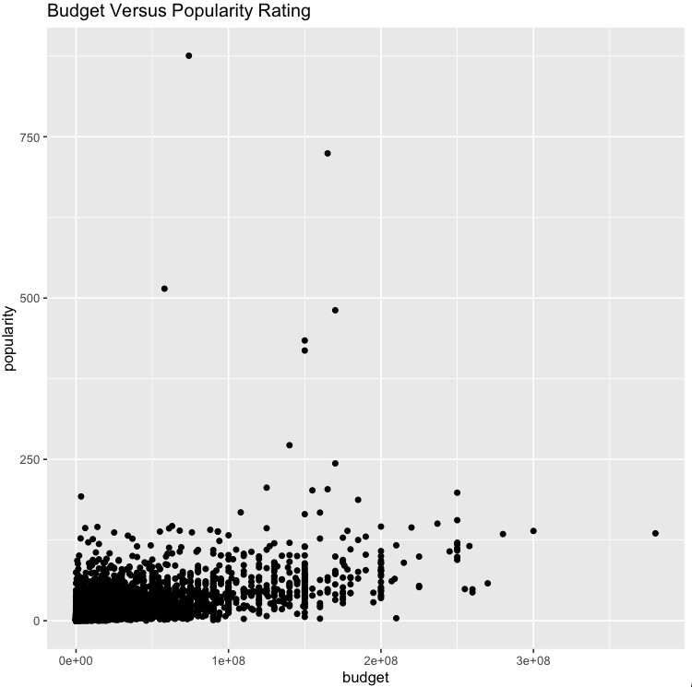
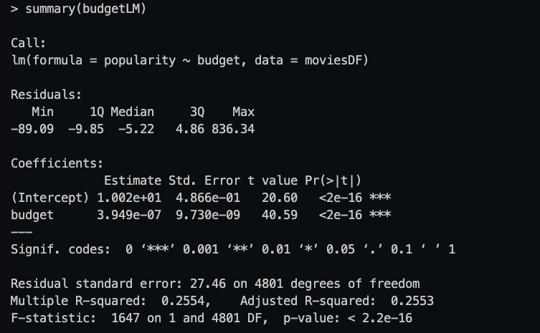
Observations – Budget Vs Popularity
Based off the output of the summary() function, Interpretation is authorized
The adjusted R-Squared – 0.2553.
This can be interpreted as approximately 25.5% of change in popularity ratings can be attributed to the budget attribute.
Scatterplot –
The resulting scatterplot shows that the dataset generally clusters in the lower left hand portion of the graph.
There are a few outliers that are displayed outside the typical x and y range for this dataset; Omission of some of these outliers may be required to create an accurate model
Bottom Line Up Front – Group E believes that multi-variable analysis is required to increase the adjusted R-squared value. However, it is interesting to see that one variable can influence 25% of change in popularity ratings. This suggests that budget is one of the key factors that influences movie popularity.

Slide 7
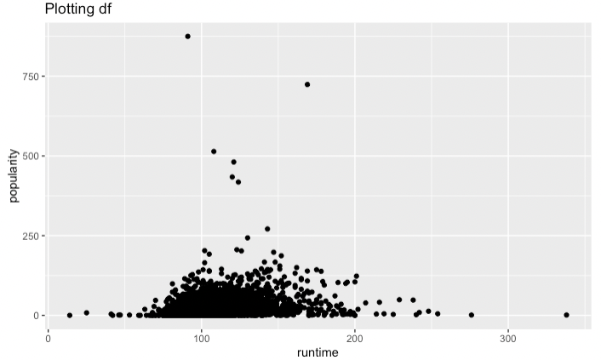
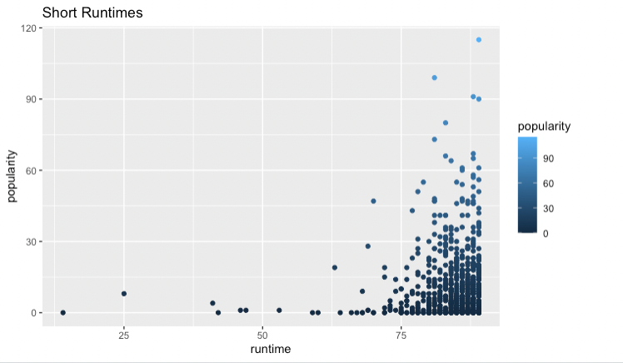
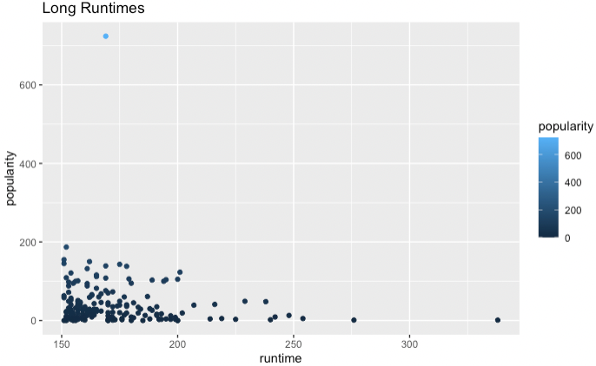
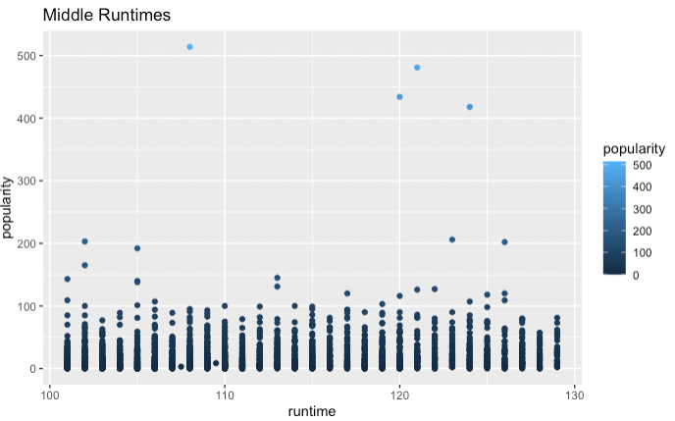
Task 2 – Analyze the relationship between Popularity & Runtime
Notes:
Based off the output of our code, we see the that runtime does indeed have an effect on a movie’s popularity. Ultimately, we see that middle runtime lengths seems to have the most clustered popularity ratings. This suggests that if a movie is too long, the popularity may be effected. Additionally, if a movie is too short, this shows that a movies popularity may be negatively affected as well. Production teams must be careful in how long they wish the final film to be in order to maximize popularity ratings.

Slide 8
Can We Conclude Runtime Affects Popularity?
In short… no. There was no indication that having a shorter or longer runtime, increases a movie’s chances of being successful. In fact, the mean of the runtime for the top 10 movies was 123 minutes, with the shortest being 91 minutes and the longest being the anomaly we saw in the longest runtimes model of 169 minutes. However, 120 minutes, 2 hours, is thought of to be the average movie runtime. Considering this is about the mean of runtimes for the top 10 most popular movies, there is no prediction that we can make right now that runtime affects the movie’s popularity.

Slide 9

Genre and Votes/Voting Average
Analyzing the Vote quantity and values compared between main genre
Sort Dataset by genres, creating subsets by genre
Analyze each for total votes and average vote value

Slide 10
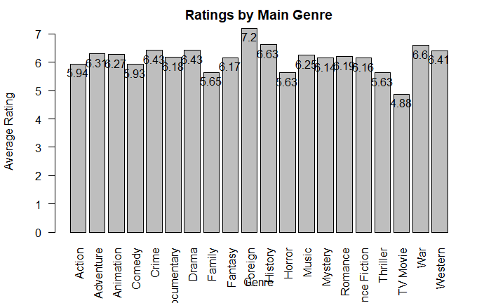
Genre and Votes/Voting Average
Does the Genre of the movie affect the Average score of votes it receives?\
Based on the Data, the average rating was highest for fantasy, and lowest for TV/Movie
All other genres averaged within .97 of eachother.

Slide 11
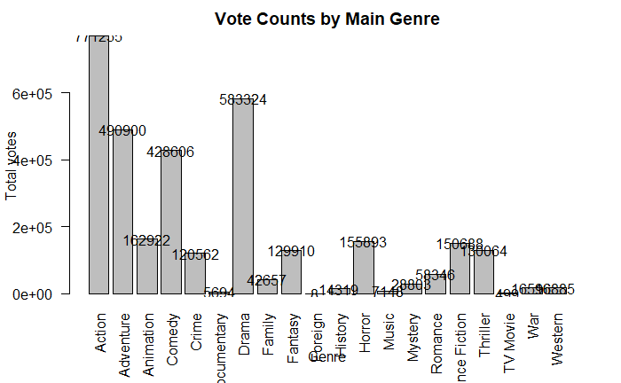
Genre and Votes/Voting Average
Does the Genre of the movie affect the number of votes it receives?
Action had a significantly higher number of vote counts than any other genre
TV movie had the least, but also the lowest average

Slide 12
Rstudio Code for analysis
Analyzing the Vote quantity and values compared between main genre
Sort Dataset by genres, creating subsets by genre
Analyze each for total votes and average vote value
Does the Anecdotal analysis stand up to data analysis?

Slide 13
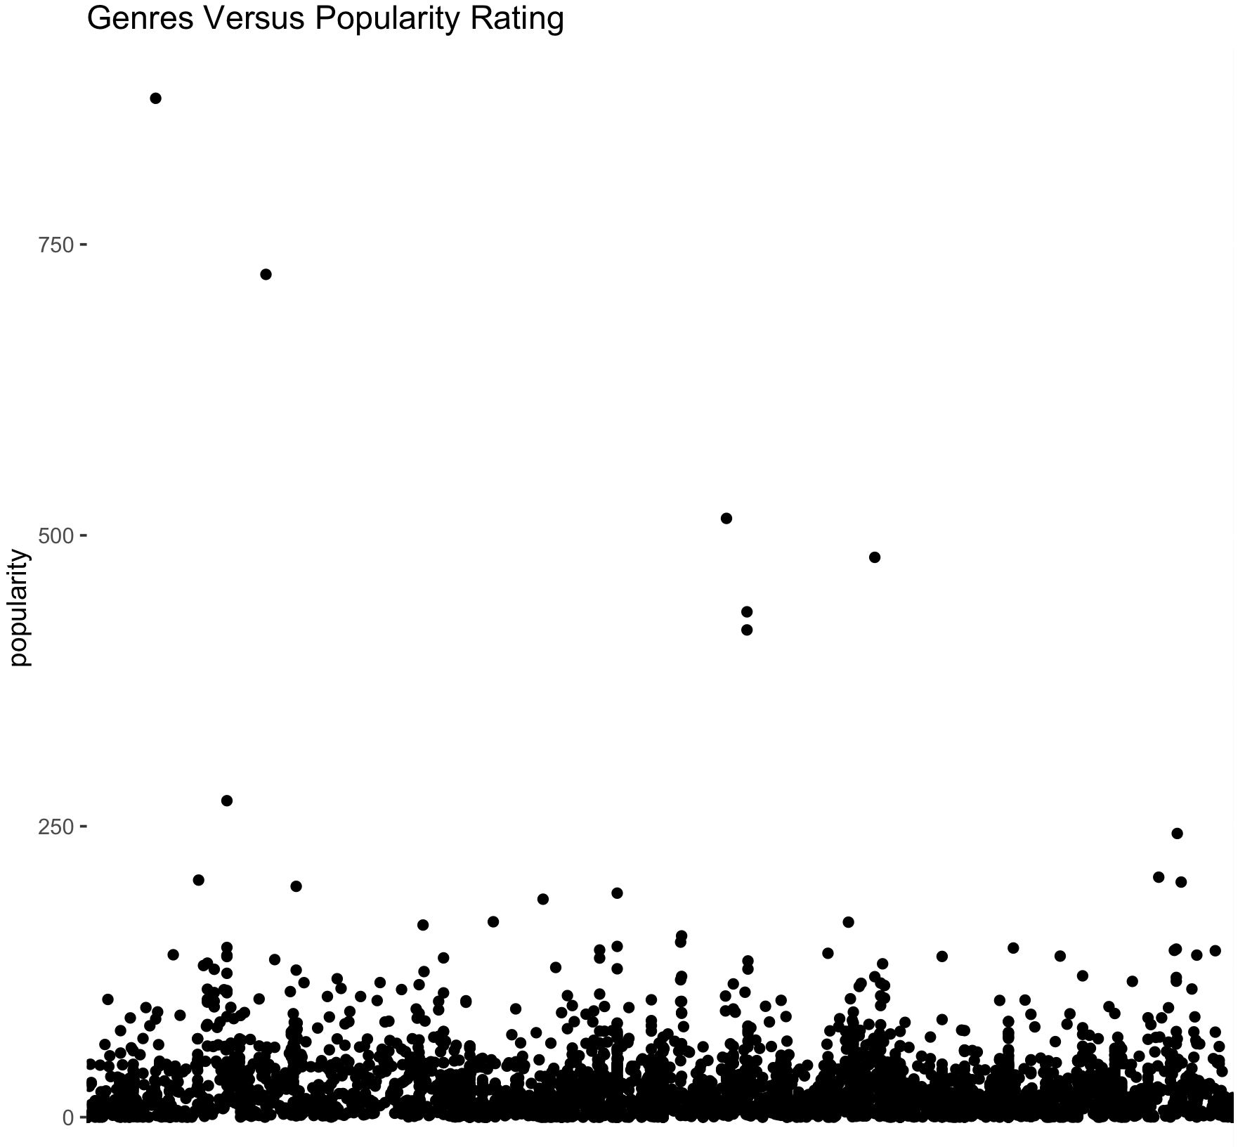
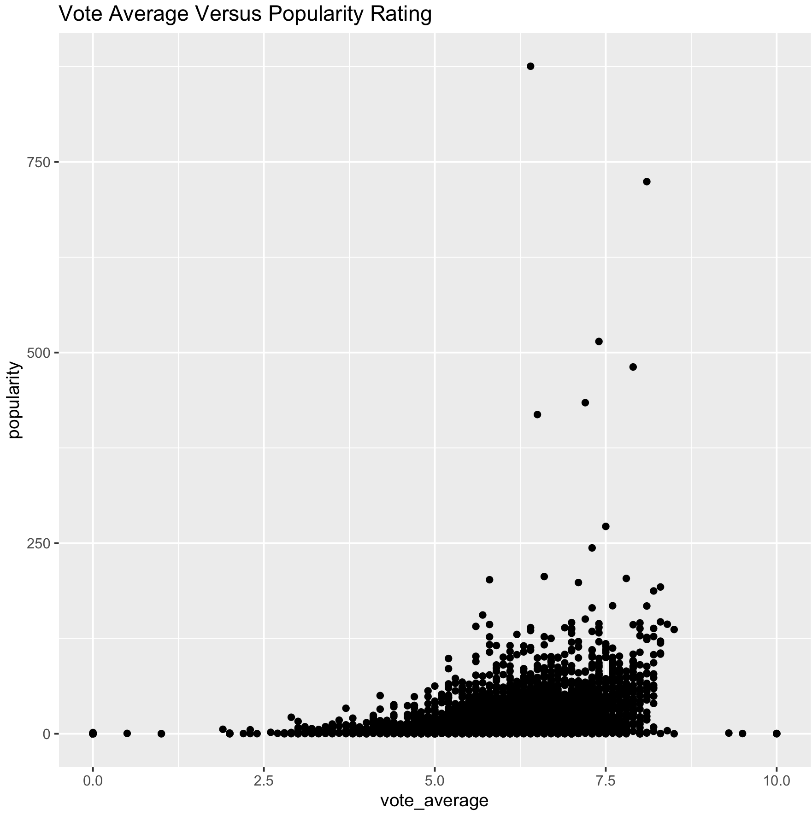
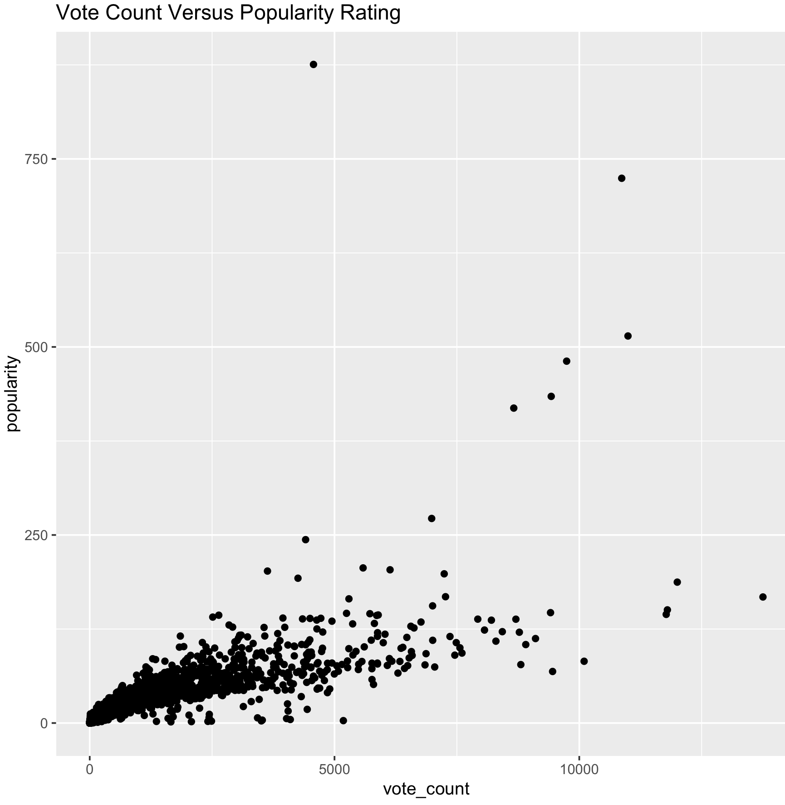
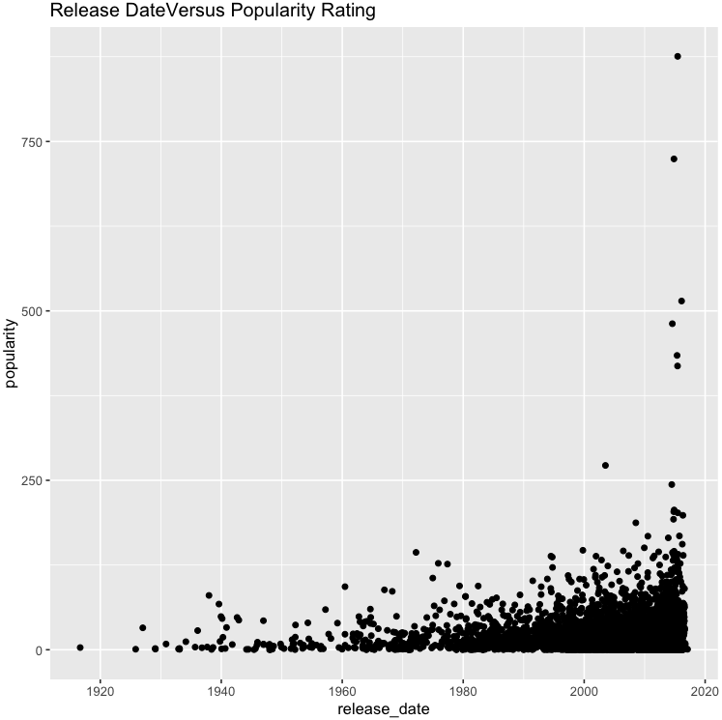
Task 2 - Multi-Variable analysis
Group E Decided to conduct initial multi-variable analysis using the following attributes as independent variables:
Budget
Genres
Runtime
Voting_average
Voting_Count
Release_date
Revenue

Slide 14
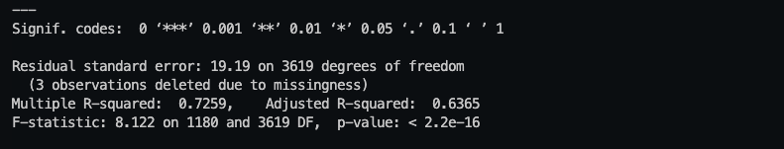
Observations – Popularity vs Multiple Independent Variables
Based off the output of the summary() function, Interpretation is authorized
The adjusted R-Squared – 0.6365
This can be interpreted as approximately 63.7% of change in popularity ratings can be attributed to the budget, genres, runtime, voting_count, and voting_average attributes.
Bottom Line Up Front – We were able to see an increase in the the adjusted r-squared value from approximately 25% to 64%. This shows that the variables we included to do further regression analysis has a stronger relationship and affect on our dependent variable, popularity. Lastly, this confirms that a movie’s popularity rating is determined by multiple factors

Slide 15

Top words in the top 10 Movies’ overviews
As you can see, after taking out stop words, numbers, and symbols, the word cloud is actually quite small compared to the dataset itself. This means overviews contain uniaue values different from other movies. Many of the repetitive words also seem to be part of the same movie overview, which would actually make this word cloud smaller than it is.

Slide 16

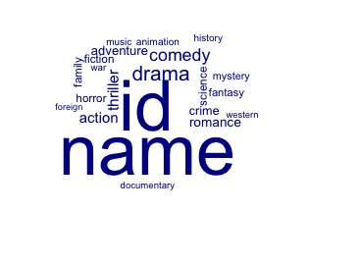
Text mining Analysis – Tagline and Genres Attributes
Tagline Word Cloud
Genres Word Cloud

Slide 17
Conclusion
Ultimately, Our group was able to identify only a handful of the 23 attributes in our dataset that influenced popularity ratings of a given movie.
We assess that our textual analysis on certain columns may need to be revised to maximize data analysis (More Data Cleaning)
Moving forward, we believe that there are missing data in our current dataset that could also influence a movie’s popularity rating ( Lead Actor/Actresses)

Slide 18
Questions and comments

Slide 19
Appendices: R-Code

Slide 20
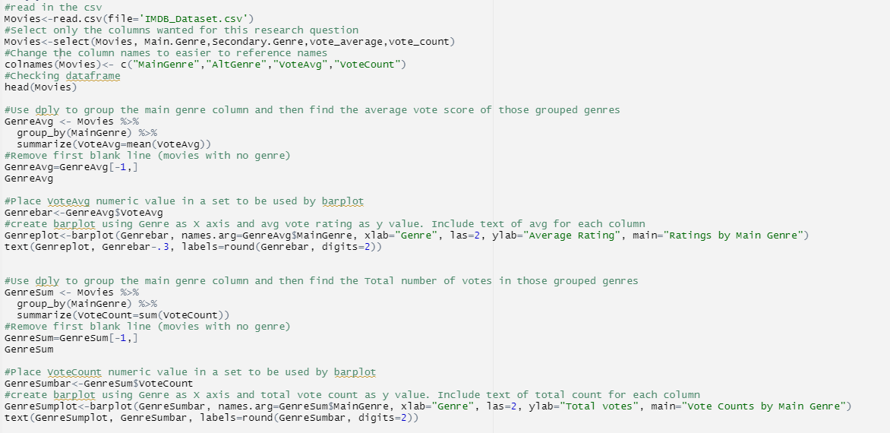
Rstudio Code for analysis

Slide 21
R- Code ( Popularity and Run Time)
#How many movies fall in each
length(shortetruntimes$popularity)
671
length(longestruntimes$popularity)
17
#Librarying
library(ggplot2)
library(tidyverse)
library(imputeTS)
library(readr)
#Mean of the shortest variables
mean(shortestruntimes$runtime)
83.77124
mean(shortestruntimes$popularity)
12.15499
#Mean of the longest variables
mean(longestruntimes$runtime)
173.6725
mean(longestruntimes$popularity)
42.35088
#Reading the file
df <- read.csv("/Users/vanessacaldera/Desktop/Syracuse University/Intro to Data Science/Final Project/Final Project Dataset.csv", header=TRUE,stringsAsFactors = FALSE)
df$runtime <- na_interpolation(df$runtime)
df$popularity <- na_interpolation(df$popularity)
#Put it all together
df <- df %>% arrange(df$runtime)
##Take away the 0
df <- df[-1:-35, ]
#Linear models
shortmodel <- lm(formula= popularity ~ runtime, data= shortestruntimes)
longmodel <- lm(formula=popularity ~ runtime, data=longestruntimes)
originalmodel <- lm(formula=popularity ~ runtime, data=df)
#Summary of linear models
summary(shortmodel)
R-Squared: 0.01491
summary(longmodel)
R-Squared: 0.009518
summary(originalmodel)
R-Squared: 0.04889
##Mean of the original df after cleaning
mean(df$runtime)
107.6543
mean(df$popularity)
2.15165
#Creating short and long runtime subsets
shortestaruntimes <- df[df$runtime > 150, ]
longestruntimes <- df[df$runtime <90, ]

Slide 22
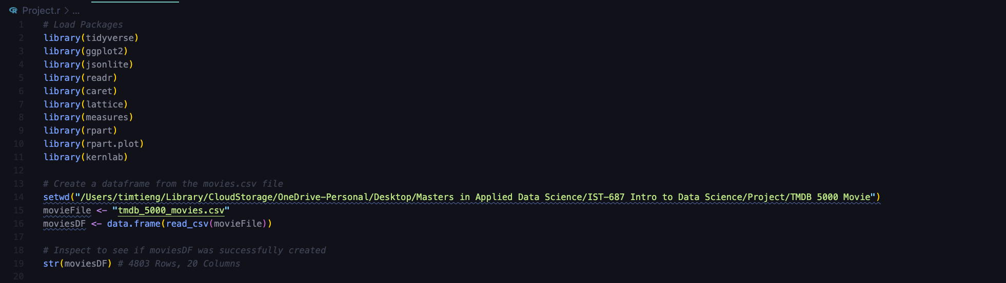
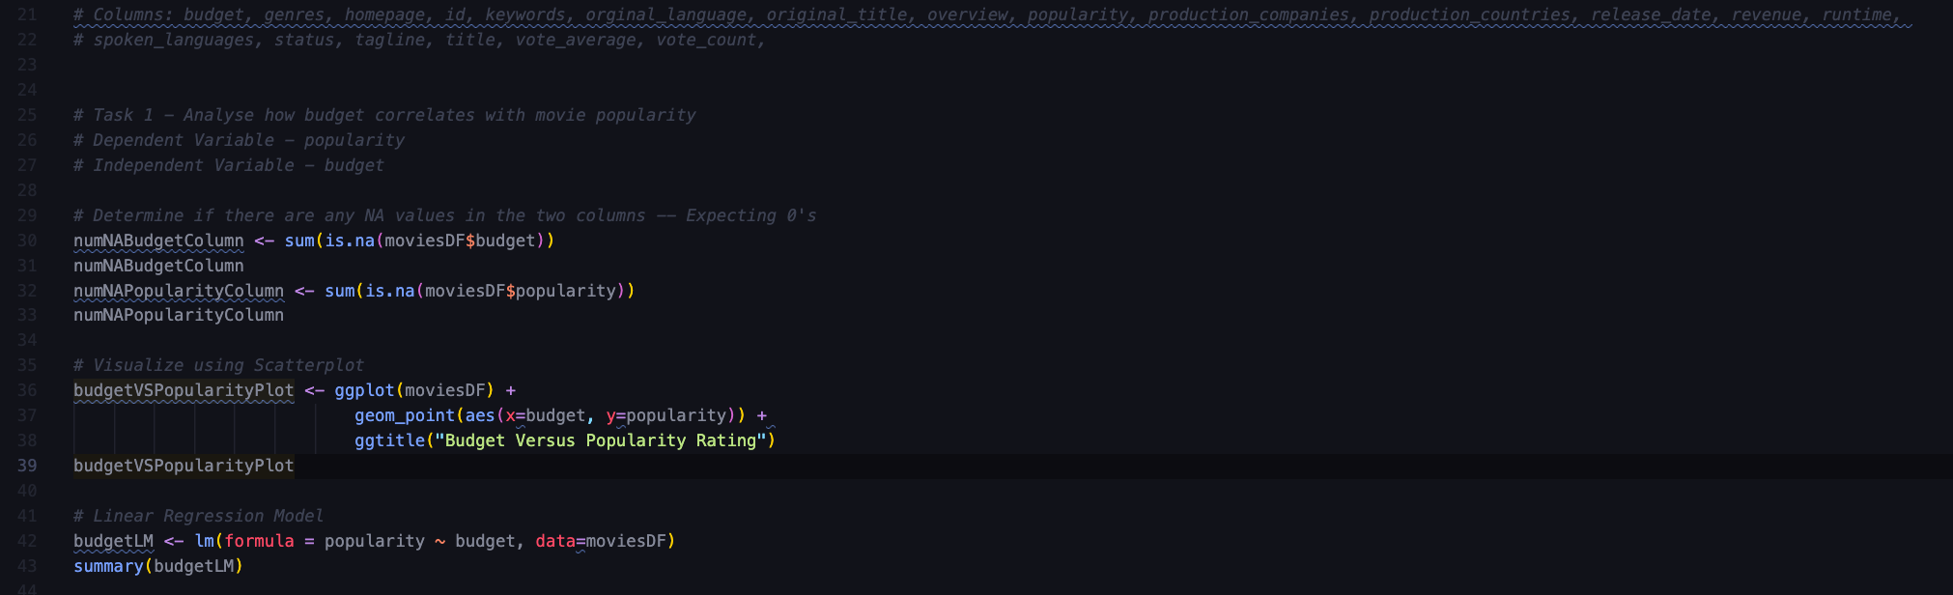
R Code – Bi-Variable and Multi Variable Analysis
**Redacted Personal File Path**

Slide 23
